Slide 1
SGO Area: Digital Commercial– Field Force Engagement
Solution Name: Mendel

Slide 2
Solution Overview
Business Objective:
Building a state-of-the-art SFE solution which will provide timely insights to Field Representatives and Area Sales Managers to take “Right Decision in Right Manner at Right time”.
Key Proposition:
Standardize promotional planning
Maximum utilization of promotional calls
Multiuser facility for cross hierarchy view
Uniform view of markets across geographies
Comprehensive evaluation of Rep’s performance
Data archiving for retrospective analysis
Differential Factors :
Application of Data Science to assess multiple touchpoints
Scalable solution for changing market aspects
Assist in designing right ‘Go to Market Strategy’
Recommendation engine for next interaction
Know Your Customer for in-depth view
Simple and Transparent process for faster adoption

Slide 3










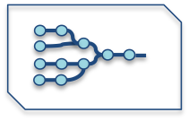

Process Overview
1
2
3
Clients from different geographies send customization request to Cognizant
Cognizant does the necessary customization in solution and shares back the version.
Setting Context: ASM and Brand Managers to identify profiling parameters within their region
4
6
Distribution among Reps: The application link is shared with field reps with latest market configuration
Tracking performance: Portfolio Owners can assess the performance and take strategic decisions.
5
Continuous Evolving Model
HCP 360 ⁰: Consumer behavior and trends using open source data
Account Profiling: Rep enters HCP interaction information .
Utilization of other Data sources: Use of available data sources (primary & secondary) for additional analysis
Segmentation : Accounts are segmented using AI/ML Clustering
NBA/NBP: Suggestion for Reps to set their strategy and goal .
Evolving Models: Inputs stored across users to study key driving factors and evolve Propensity model

Slide 4



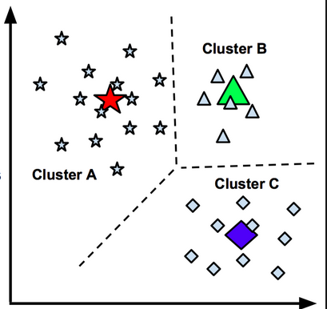



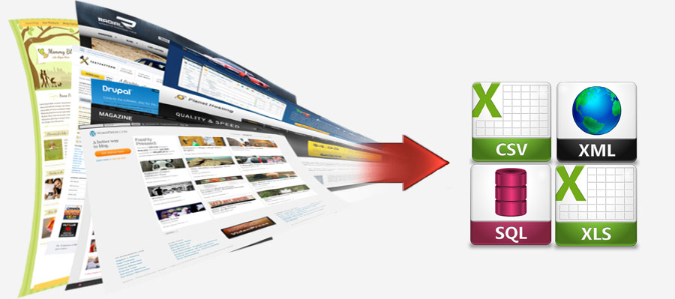

Functional Overview
Data layer
Business Logic Layer
Interaction Layer
Clustering
Analysis
Data Components
Target Definition
Data Input
Target List
Target Ranking
DW / Data Lake
Visual Representation of Clusters
Set up qualitative evaluation criteria based on brand
Tune scores and weight of each criteria.
Rep to provide information for each physician / Account
Clustering using quantitative and qualitative parameter
Ranked Target list with propensity score for each HCP
NBP/NBO for each HCP
Account Analysis
Rx data
Alignment Data
HCP Data
Calls data
Clickstream data
DDD Sales
Etc..
Performance of Physician/Account`
Territory Analysis
Web Scrapping
Performance of Reps/Territory
Customer 360
Cafe Pharma
Viva Open data
NPI Federal site
Etc..
Detail view of HCP
Information Flow

Slide 5
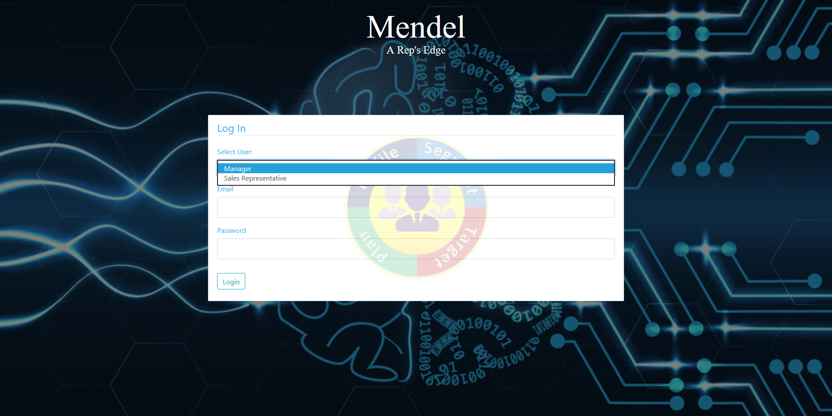
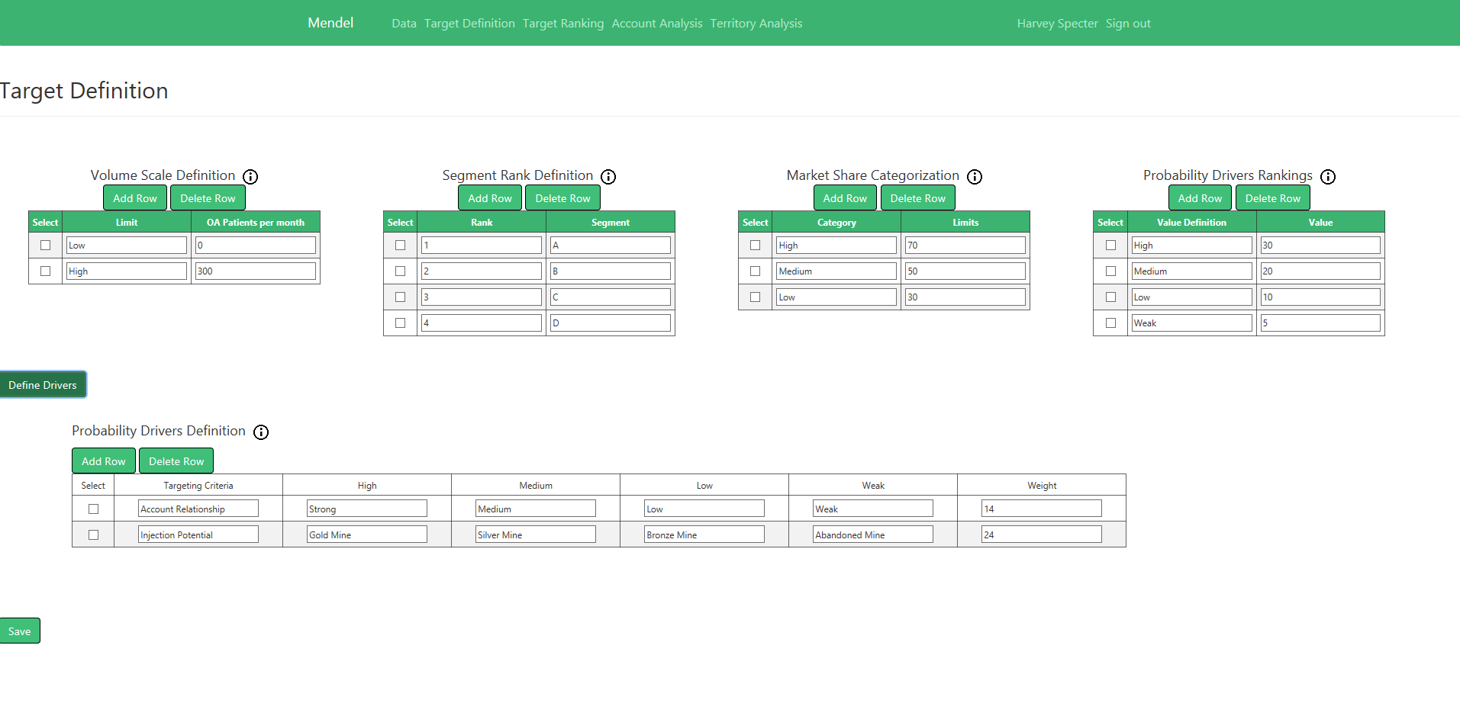
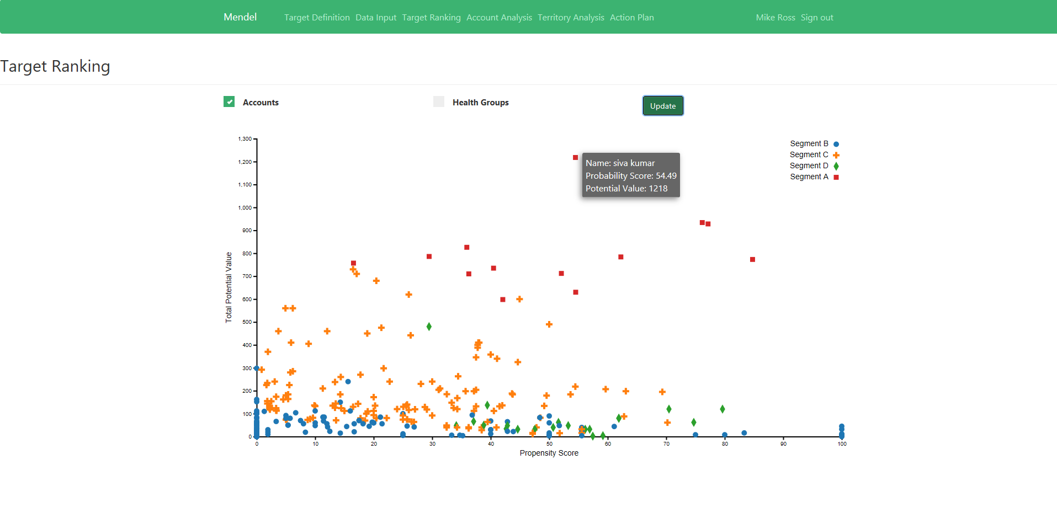
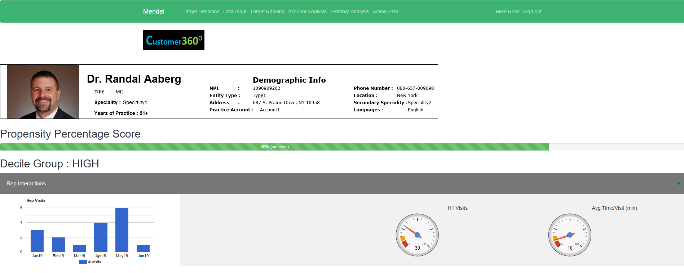
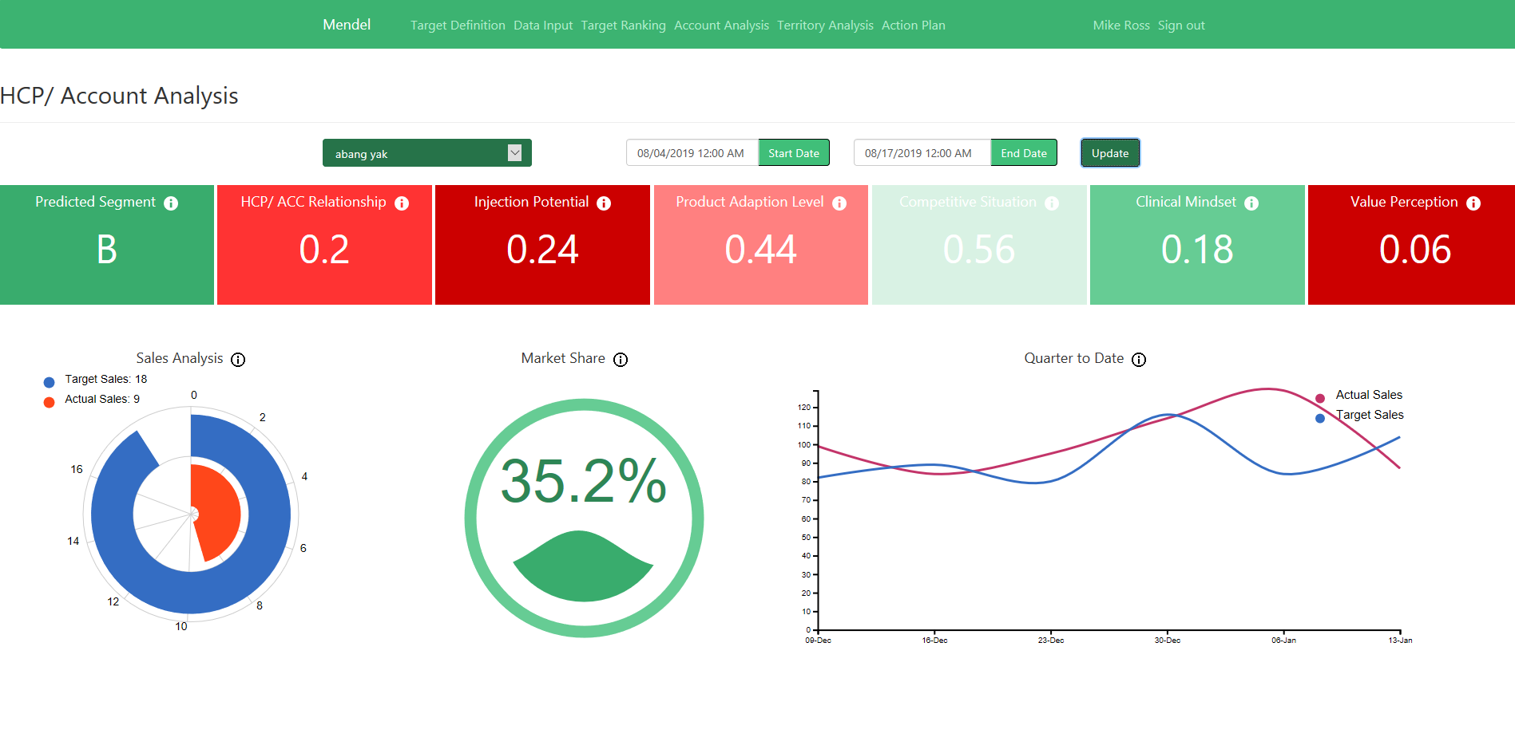
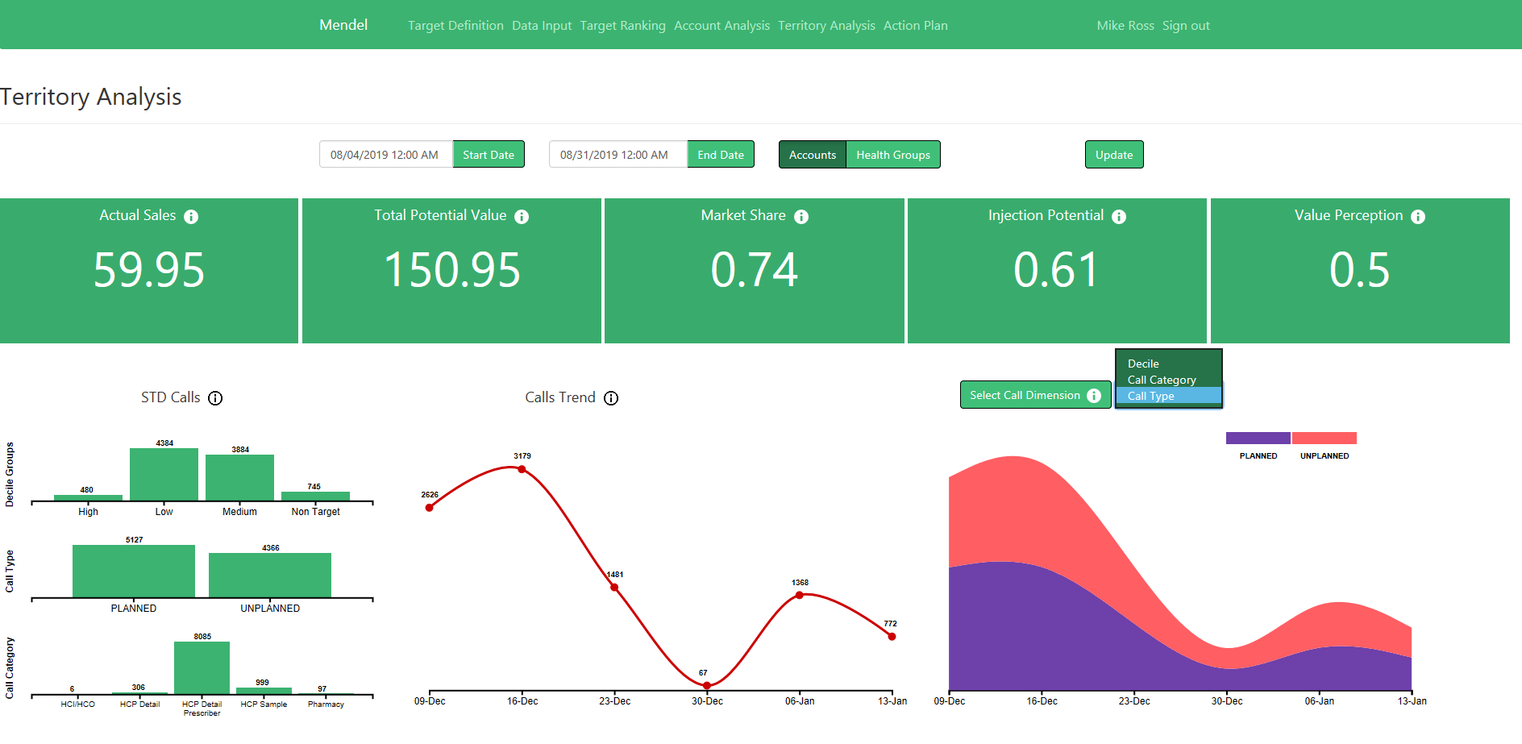
Application Snapshots (Proto-Type)

Slide 6





Solution Key Features
Standardized Process
For better evaluation across market but with flexibility to address custom market needs…..
Customer 360⁰ View
For more intel on customer behavior and tailored targeting approach …..
AI/ML Approach
For perfect mix of human (domain) intelligence with data driven insights…
Flexible Rollout
Modular approach to integrate with existing tools/platforms like SAP, Veeva, Javelin, Navigator, etc….
Rapid Deployment
Light tool simple database configuration mechanism for quick release ..

Slide 7









Recommendation Engine (Approach)
Cluster Analysis
Segment
Classification
Model
Propensity Score
Affiliation
Alignment
Call Activity
Call Plan
Physician
Prescription
Profiling
Recommended target list of HCP/ Accounts
Suggestions for next best plan/actions/offer
Suggestion Engine
Hybrid approach for recommendation
combining machine learning algorithm,
which provides a trained base model complementing
with a rule-based expert system
Call
Mail
Rep Call
ISA Call
Sample
Past Touchpoint
Next Touchpoint/Offer
High Potential
Low Royalty
Customer Journey
High Potential
High Royalty

Slide 8


Customer 360⁰ View
NLP with Deep Learning
Unstructured Data
Sentimental analysis using summarization of Patient and other reps feedback and Experience
HCP KPI Summarization
Web Scrapping
Descriptive Analytics
Decile
Demographic details
Affiliations
Payment data
Engagement Channel
Behavioral Info
Structured Data
Customer 360 Data Store
Cafe Pharma
Viva Open data
NPI Federal site
Health News
CMS Payment
OPEN SOURCE
Calls, Emails, Digital Touchpoints, SFE data from tool
Client System
QUANT Modelling
Clustering, Propensity Score

Slide 9


Strategical and Tactical Benefits
Strategic
Tactical
Centralization of SFE activities for leadership to have uniform view and comparison of one region with another.
Reduce cycle time of Segmentation and Targeting using AI/ML for higher focus on strategies and call planning
Propensity score for each HCP/Account to drive customized marketing strategies
Customer 360 view leveraging both traditional and Open source data to help reps take informed and instant decisions
NBA/NBP engine to provide best probable offer suggestions for each customer
Out clustering approach (Elbow method K Means) by considering the key influential factors will help Clients in developing optimum call plans and arrive at the best suited sets of clusters
Propensity score for each physician will help client to identify the key writers as well as understand the various factors for prescription writing
Client can redefine the target list and change messaging pattern for the segmented physicians
Performance analysis provided in the application can help organization to plan their Rep’s IC plan better

Slide 10
Thank You
Please contact Raju Chowdhury (Raju.Chowdhury@Cognizant.com) for any additional details.

